Slide 1
Credit EDA Assignment
Should you get the loan? Will you pay the loan on time?
      Deekshashree KM

Slide 2
Problem Statement:
When the company receives a loan application, the company has to decide for loan approval based on the applicant’s profile. Risks associated with the bank’s decision:
Not approving loan to applicant who can repay the amount.
Approving loan to applicant who can't repay or likely to default.
Both result in loss of business to the company. So, The loan providing companies find it hard to give loans to the people due to their insufficient or non-existent credit history. Because of that, some consumers use it as their advantage by becoming a defaulter.
Data given in ‘applicant_data' file contains the information about the loan application at the time of applying for the loan. It contains two types of scenarios:
The client with payment difficulties: he/she had late payment more than X days on at least one of the first Y instalments of the loan in our sample (Defaulters)
All other cases: All other cases when the payment is paid on time.(Non-Defaulters)
Data given in 'previous_application' contains information about the client’s previous loan data. When a client applies for a loan, there are four types of decisions that could be taken by the client/company):
Approved: The Company has approved loan Application
Cancelled: The client cancelled the application sometime during approval. Either the client changed her/his mind about the loan or in some cases due to a higher risk of the client he received worse pricing which he did not want.
Refused: The company had rejected the loan (because the client does not meet their requirements etc.).
Unused offer: Loan has been cancelled by the client but on different stages of the process.

Slide 3
Objective:
To identify patterns which indicate if a client has difficulty paying their installments (i.e., company wants to understand the driving factors/variables or strong indicators behind loan default) Based on the trend analysis/ result, company can: Deny loan, Reduce amount of loan or lend loan at high interest to risky applicant. Also, applicants who are capable of repaying the loan are not rejected.
In this case study, will use EDA to understand how consumer attributes and loan attributes influence the tendency of default.

Slide 4
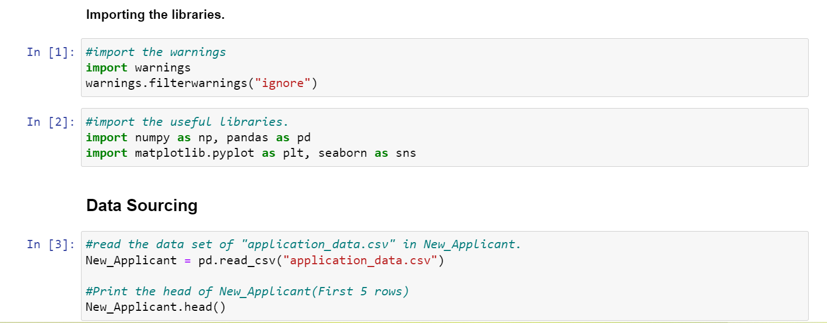

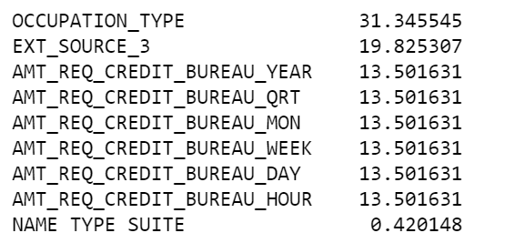
Required libraries are imported and loaded data set.
Data cleaning activities:
Application_data was initially checking for missing values.
Columns having more than 40% of null values were dropped, as it’s insufficient for analysis.
Columns having less than 40% of null values were checked if those missing value can be imputed or ‘dropna’ related rows
Column name
Null %

Slide 5
Impute Missing values
‘OCCUPATION_TYPE’ column had 31% null values. Occupation type had multiple categories and required column data. So, to impute the missing data checked for ‘mode’ (most frequent type), since, it’s categorical column and distribution mode has ‘Laborers’ contributing 26% data. But can't replace 31% missing data with laborer as this would impact the analysis. Hence, missing values are retained as is.
‘AMT_REQ_CREDIT_BUREAU’ columns had 13% missing data. Maximum distribution of data was seen at one value. Hence, dropped the rows with missing value here as this missing data will not have major impact to column (the column already has constant/max value for analysis, if required)
Similarly for ‘NAME_TYPE_SUITE’ column, Maximum distribution of data is seen at one value. Hence, dropped the rows with missing value.
AMT_ANNUITY column had very less % of null value. Since it’s a numerical column-checked for outliers if missing value can be replaced with Mean or median. And there were Outlier in the annuity, as the difference between max value and 75% values was high. So, the missing value was replaced with Median value.
Columns with no significant data for analysis were dropped- 'EXT_SOURCE_2', 'EXT_SOURCE_3','FLAG_DOCUMENT_2', 'FLAG_DOCUMENT_3','FLAG_DOCUMENT_4', 'FLAG_DOCUMENT_5', 'FLAG_DOCUMENT_6','FLAG_DOCUMENT_7', 'FLAG_DOCUMENT_8', 'FLAG_DOCUMENT_9','FLAG_DOCUMENT_10', 'FLAG_DOCUMENT_11', 'FLAG_DOCUMENT_12’, 'FLAG_DOCUMENT_13', 'FLAG_DOCUMENT_14', 'FLAG_DOCUMENT_15', 'FLAG_DOCUMENT_16', 'FLAG_DOCUMENT_17’, 'FLAG_DOCUMENT_18','FLAG_DOCUMENT_19', 'FLAG_DOCUMENT_20', 'FLAG_DOCUMENT_21’.
Further, data in each columns were checked to identify errors in data and data type.

Slide 6
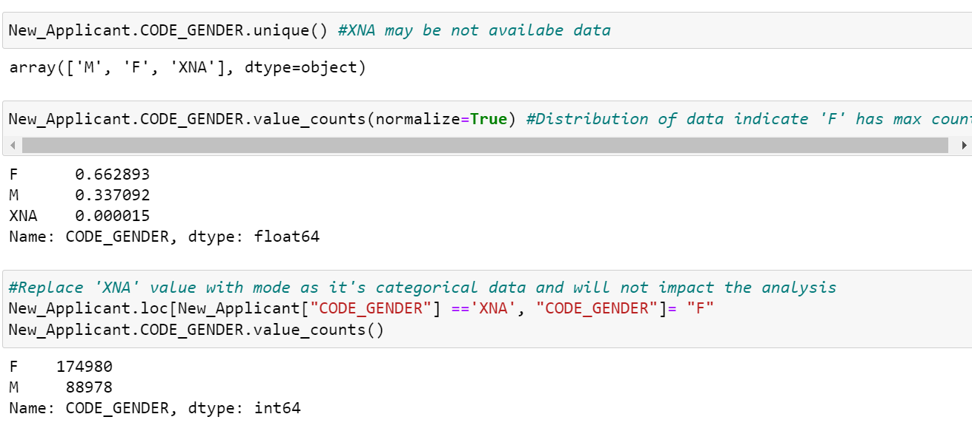
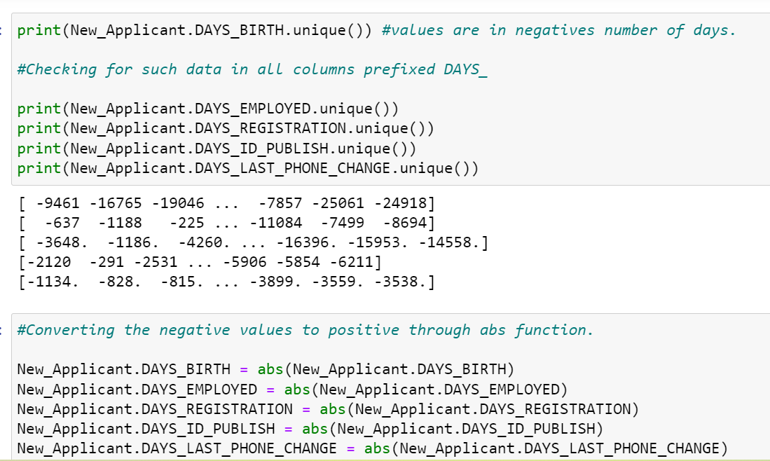
Errors in data
Gender had ‘XNA’ which may be not available data. Since, it’s categorical data, replaced it with distribution mode- Female ‘F’.
Errors in data
Columns prefixed DAYS_ has negative values for no. of days.
So, values are converted to positive number using absolute function ‘abs()’

Slide 7
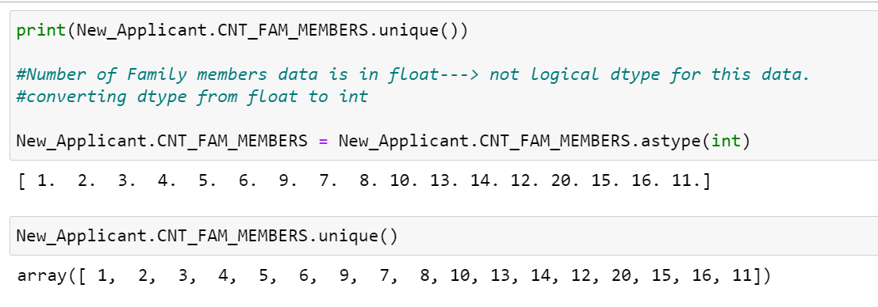
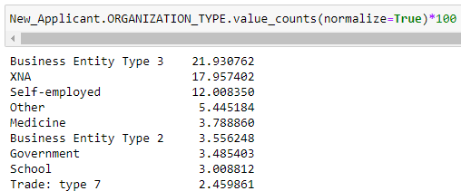
Number people can’t be counted in decimals. Family member column datatype is changed to int from float
Similarly, for ORGANIZATION_TYPE column had ‘XNA’. Again, its categorical column, so, checked for Mode. Distribution of data is across and has mode as 'Business Entity Type 3’ of 22%.
Replacing ‘XNA’ data with mode 'Business Entity Type 3' will impact the analysis as data is distributed across 58 unique categories. So, XNA data in ORGANIZATION_TYPE were dropped.

Slide 8
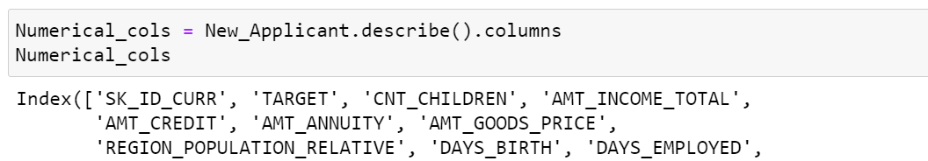
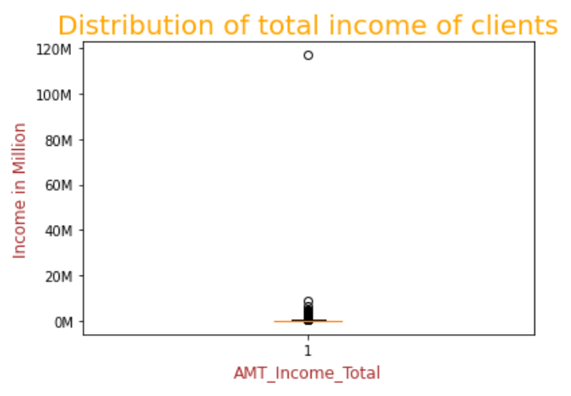
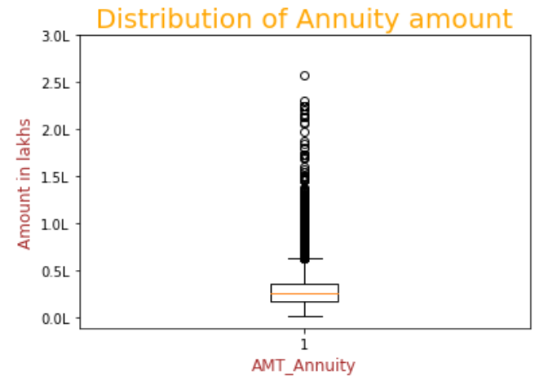
Identify Numerical columns and check for outliers in it.
Fig 2
Fig 1
Fig 1
Fig 1: In the above boxplot of AMT_Income_Total, we can observe outliers- Max income 117000000 (near to 120M) is surely an outlier here.
Fig 2: In the above boxplot of AMT_Annuity, we can observe some outliers. Max loan annuity at 2.5L appears to be an outlier here.

Slide 9
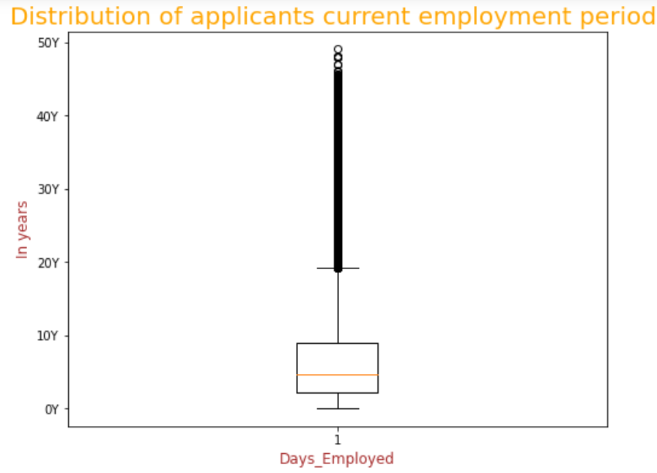
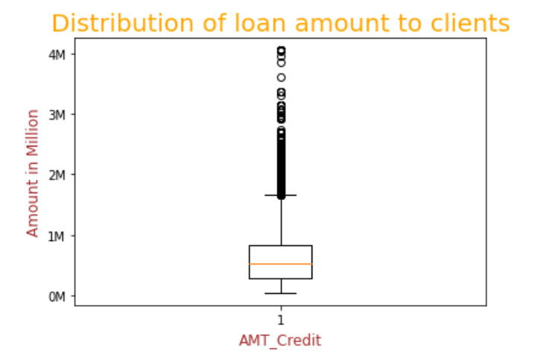
Fig 3
Fig 4
Fig 3: In the above boxplot of DAYS_EMPLOYED, there is values near to 50 years is surely outlier. As per DAYS_BIRTH data, applicants Max age here is 69 years. Considering that, lets say applicant started working early in 21 years to which if we add the outlier values (ex: 21+49) that gives applicant age as 70-- serving in the same office where he/she started without retirement?!..
Fig 4: In the above boxplot of AMT_Credit, we can observe some outliers. Considering the income of the applicant loan credit can vary and can't deem Max loan credited (4 Million) as outlier.

Slide 10
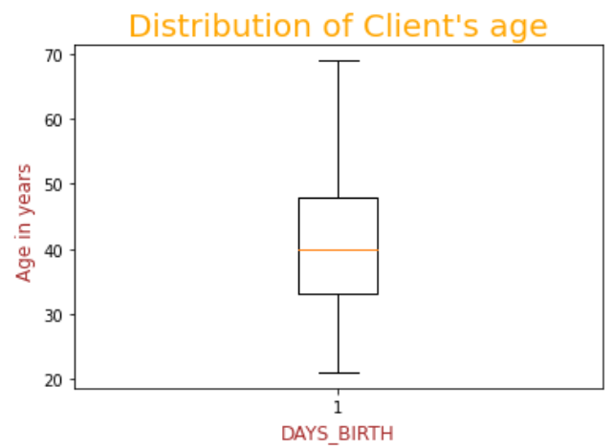
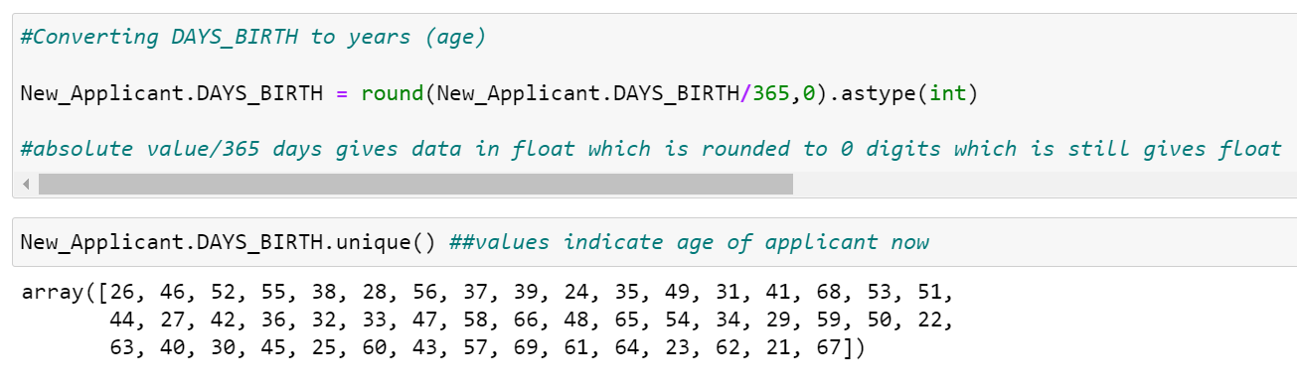
Fig 5
Fig 5: In the above boxplot of DAY_BIRTH, there are no outliers w.r.t age.
Next, creating bins for Continuous variables/columns: AMT_INCOME_TOTAL, AMT_CREDIT and DAYS_BIRTH for further analysis.
‘DAYS_BIRTH’ column had data in number of days, which were converted to years (age of the applicants) here

Slide 11
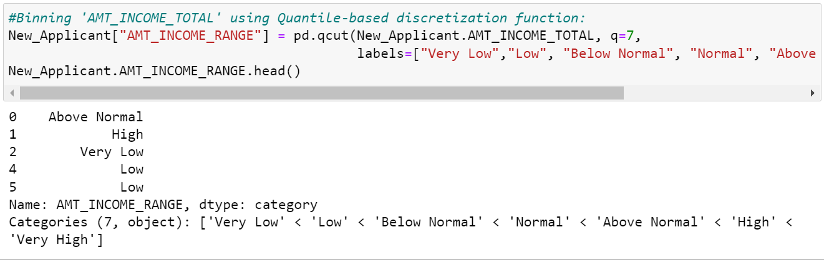
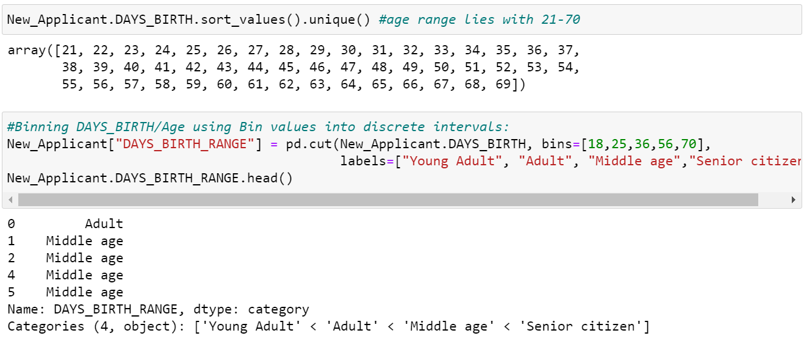
Binning of Continuous variables
‘AMT_INCOME_TOTAL’ and ‘ AMT_CREDIT’ numerical data were converted to categorical data based on range buckets by creating new col ‘AMT_INCOME_RANGE’ and ‘AMT_CREDIT_RANGE’.
Similarly, applicant ‘Age’ numerical data were converted to categorical data based on range buckets by creating new column ‘DAYS_BIRTH_RANGE’

Slide 12
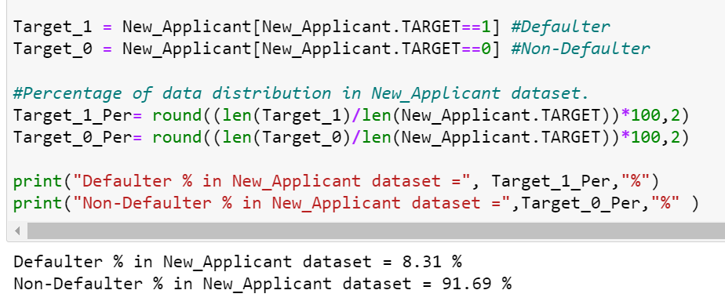
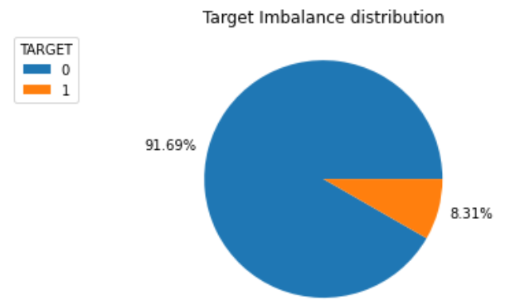
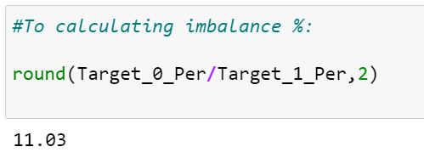
Imbalance Percentage between 1(Defaulter) and 0 (Non-Defaulter), in Target variable:
‘New_Applicant’ dataset is divided into 2 set based on values in Target column:
  Target_1(Defaulter)
  Target_0(Non-Defaulter)
Fig 6
Fig 6: We can observe majority of data is seen in Target_0 (Non-Defaulter) dataset. Overall, 8.31% clients are defaulters in the given dataset.
Imbalance ratio is 11.03. There is an imbalance in the target variable where 8.31% of the clients are found to be defaulter and 91.69% are found to be non-defaulter.

Slide 13
Univariant analysis for different categorial data

Slide 14
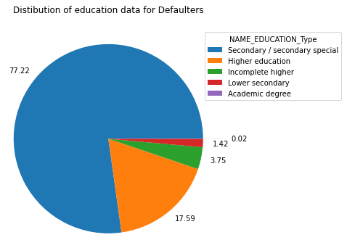
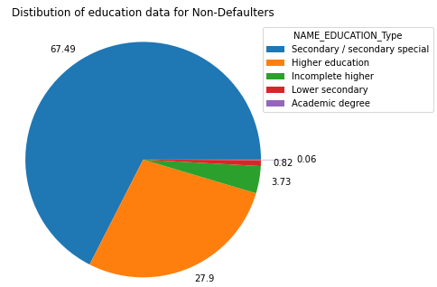
EDUCATION TYPE:
By comparing % of Defaulter and Non-Defaulter education qualification, We can observe :
  Increase in percentage of Defaulters who has "Secondary/Secondary special" education.
  Decrease in percentage of Defaulters who has "Higher Education".

Slide 15
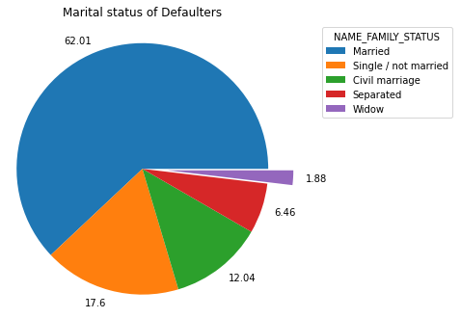
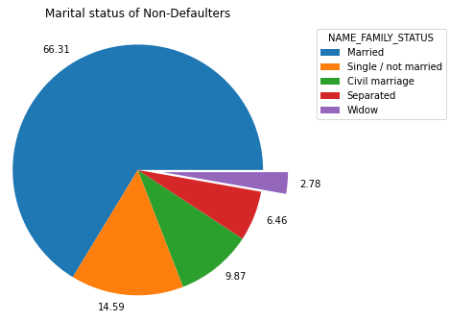
NAME_FAMILY_STATUS (Marital Status)
By comparing % of Defaulter and Non-Defaulter marital status, We can observe :
  Increase in percentage of Defaulters who are "Single" and 'Civil Married’.
  Decrease in percentage of Defaulters who are "Married" and 'Widow’.

Slide 16
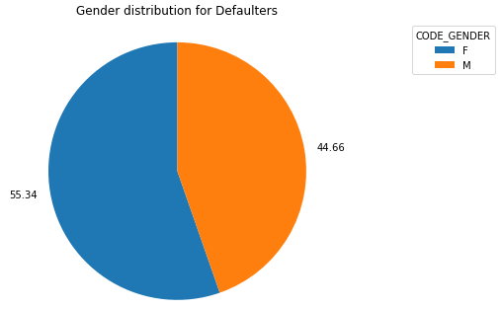
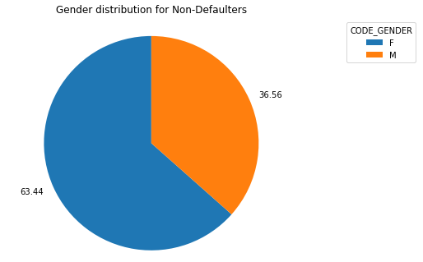
GENDER:
In both cases we can observe female are majority in both cases.
By comparing % of Defaulter and Non-Defaulter gender, we can observe:
  Increase in percentage of Male Defaulters.
  Decrease in percentage of Female Defaulters.

Slide 17
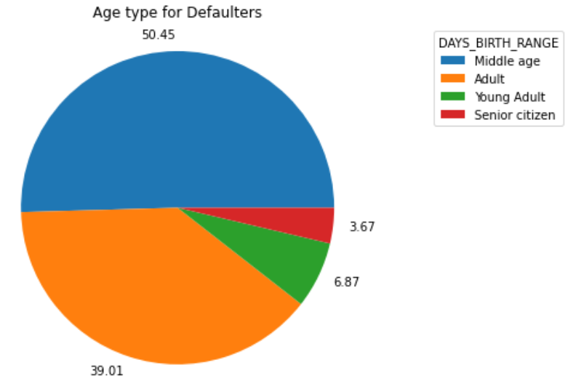
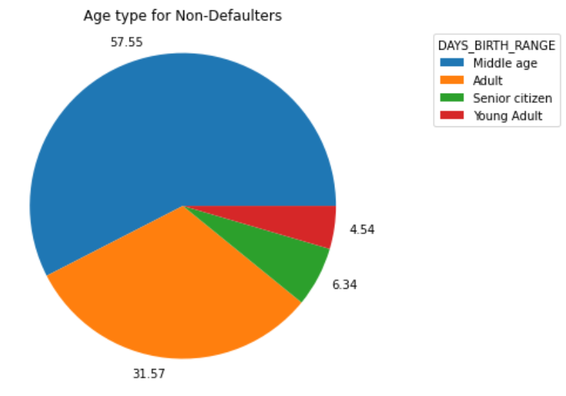
AGE:
By comparing % of Defaulter and Non-Defaulter age group, We can observe :
  Increase % of Defaulters who are Young adults and Adults.
  Decrease % of Defaulters who are Senior citizen and Middle Aged.

Slide 18
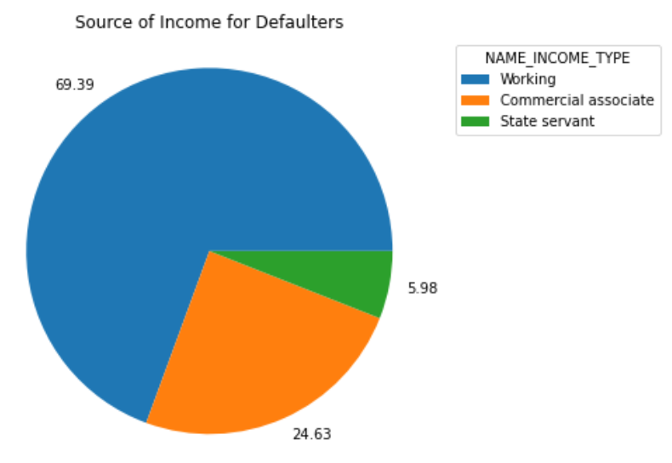
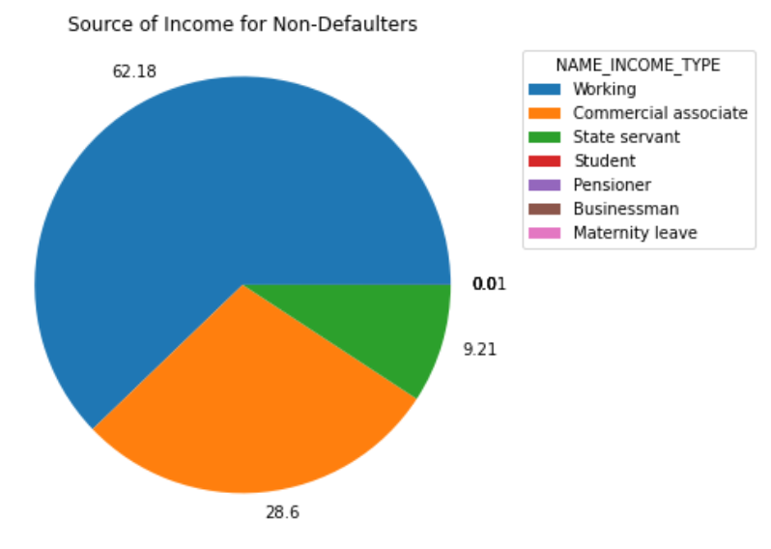
Source of Income:
We can observe defaulters Income type mainly falls under Working, Commercial associate & State servants category. In comparison with defaulter and non-defaulter % graph, we can say that:
  Increase in percentage of defaulters who are 'working'.
  Decrease in percentage of defaulters who are 'Commercial associate' & 'State servants'.

Slide 19
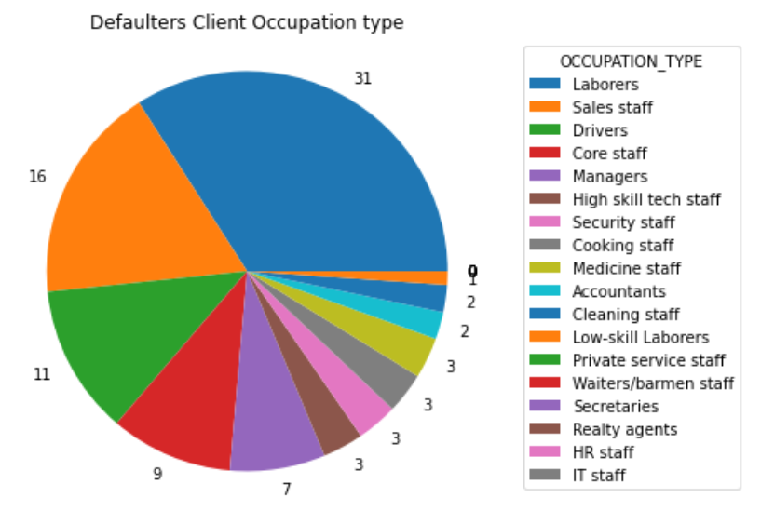
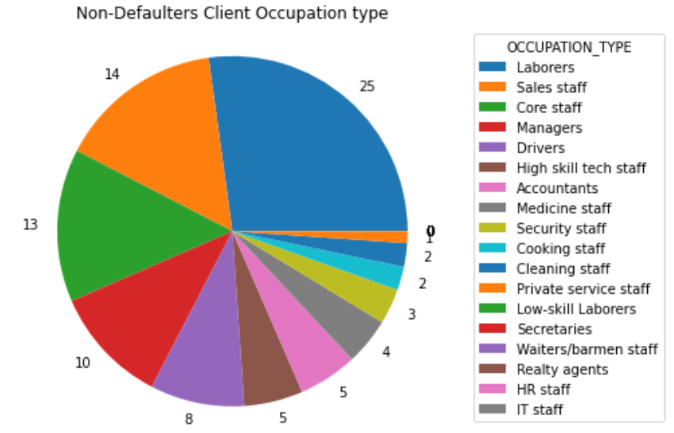
Occupation type:
In comparison with defaulter and non-defaulter % graph, We can observe:
  Increase in defaulter % who are 'Laborers', 'Sales staff', 'Drivers’
  Decrease in defaulter % who are 'Core staff’.

Slide 20
Univariant analysis for different Numerical data

Slide 21
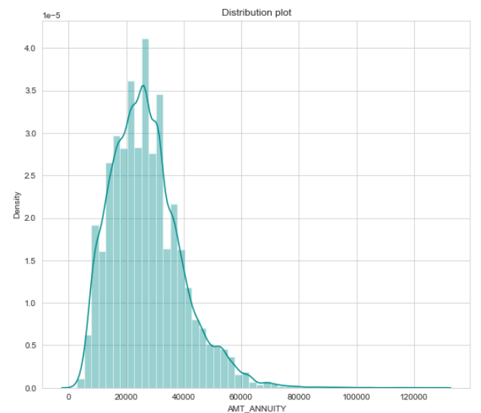
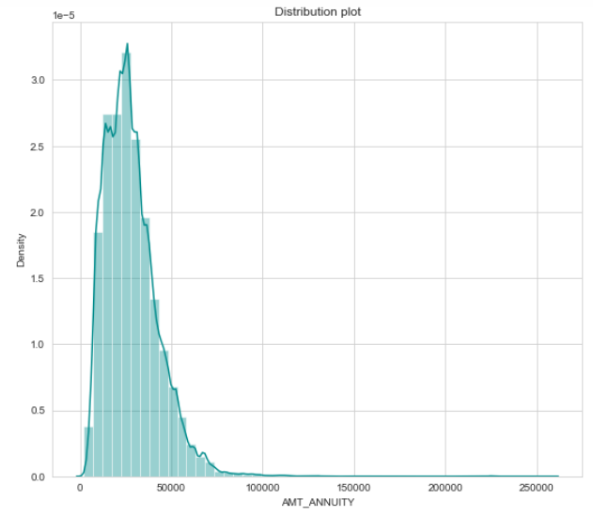
Loan annuity
Defaulters
Non-Defaulters

Slide 22
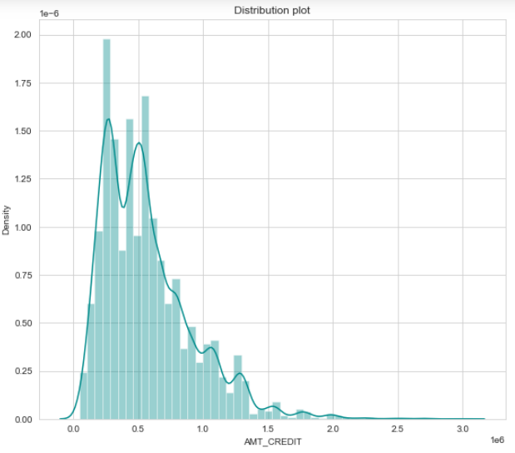
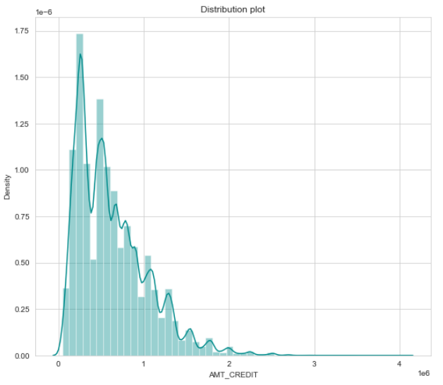
Loan Credit:
Defaulters
Non-Defaulters

Slide 23
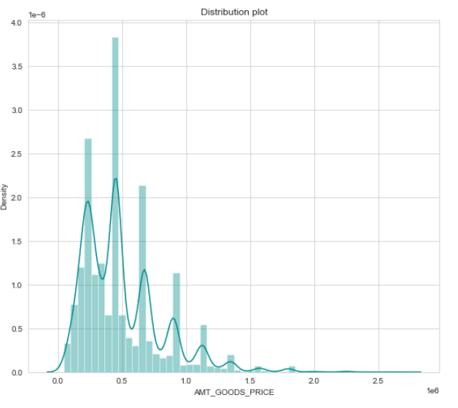
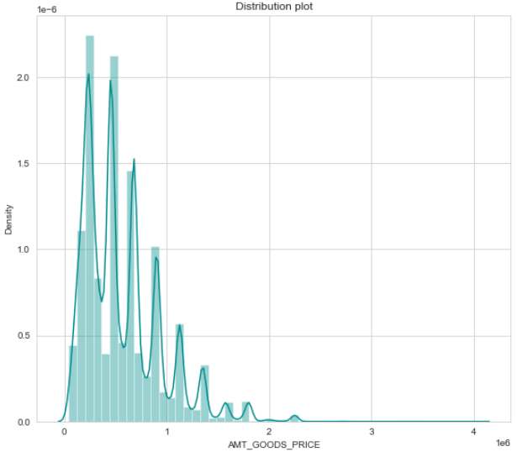
Goods Price
Defaulters
Non-Defaulters

Slide 24
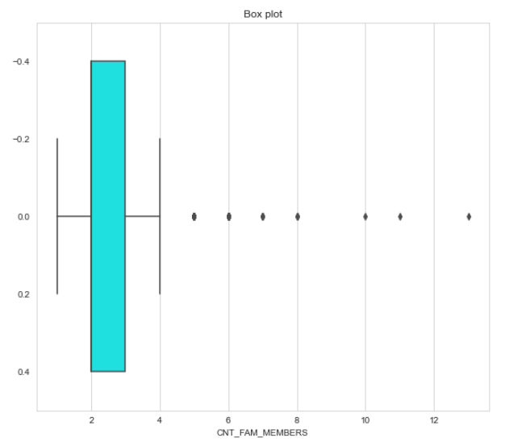
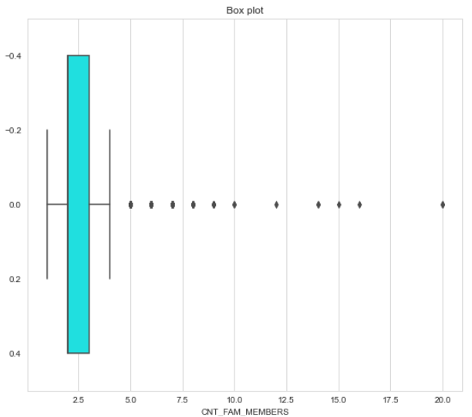
Family members
Defaulters
Non-Defaulters

Slide 25
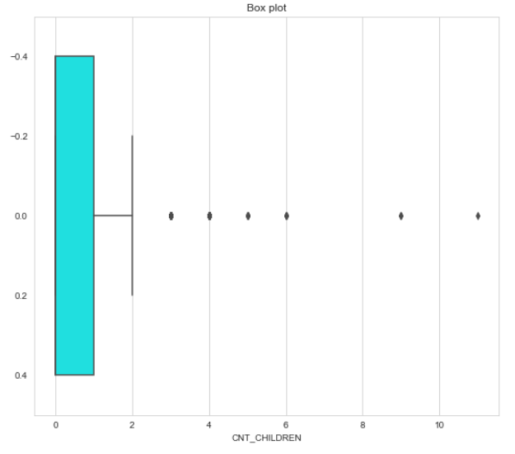
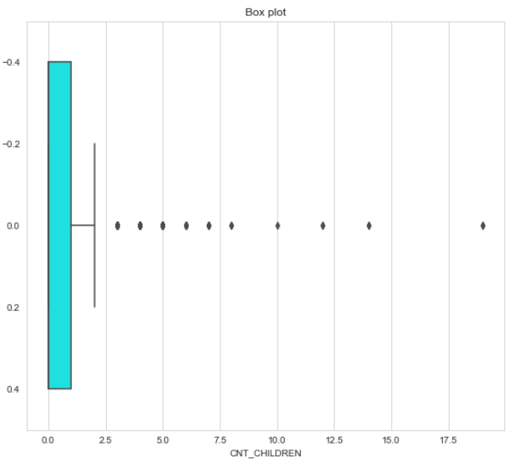
Number of children
Defaulters
Non-Defaulters

Slide 26
Bivariate analysis
for categorical variables vs numerical variables

Slide 27
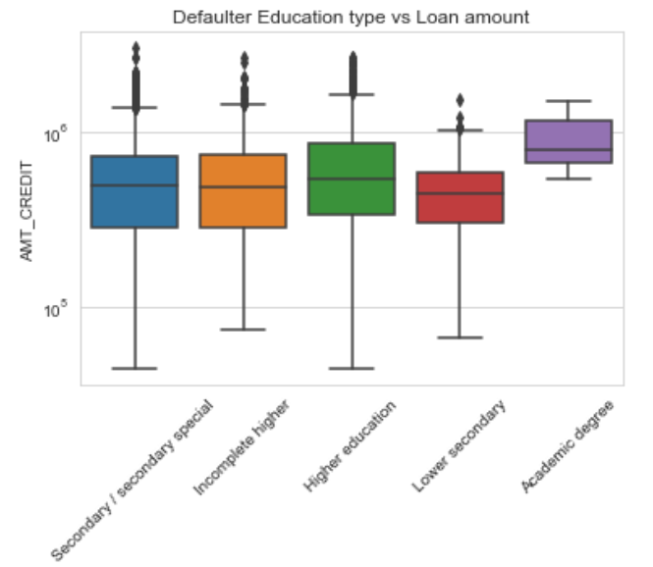
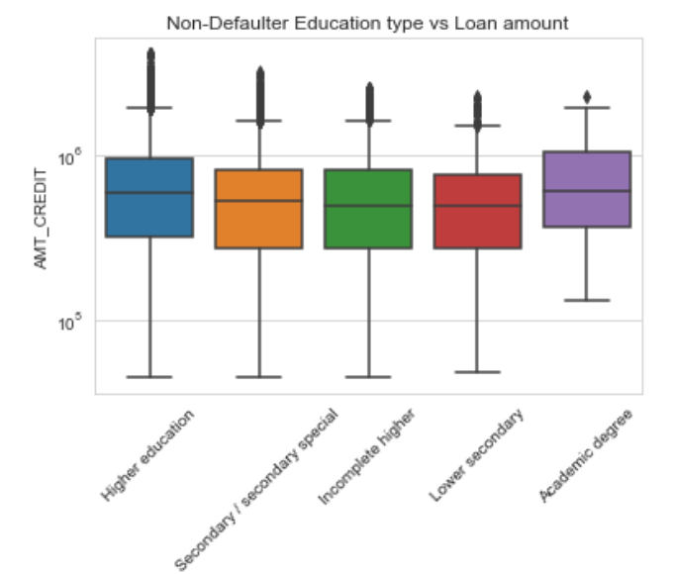
Education type vs Loan amount
In the above graphs of Education type vs loan amount for Defaulter and Non-Defaulter, we can observe
Secondary and incomplete higher education type applicant are on higher side of defaulter
Defaulter applicant with Academic degree type of education are having higher credit/loan amount than others.

Slide 28
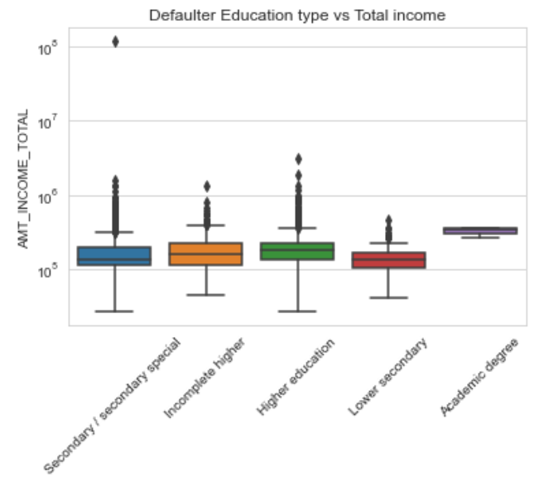
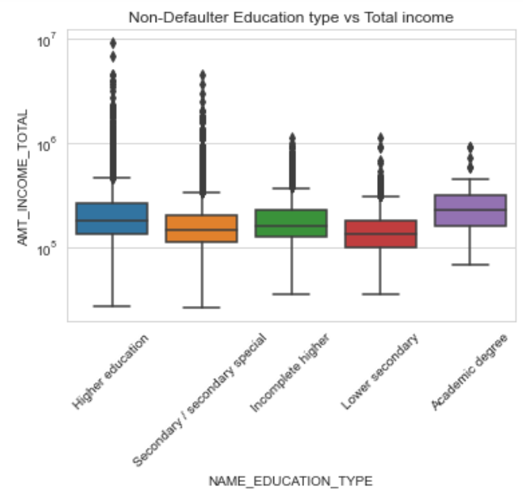
Education type vs Income
In the above graphs of Education type vs Total income for Defaulter and Non-Defaulter, can observe Defaulter applicant with Academic degree are having higher income than others at low extreme.

Slide 29
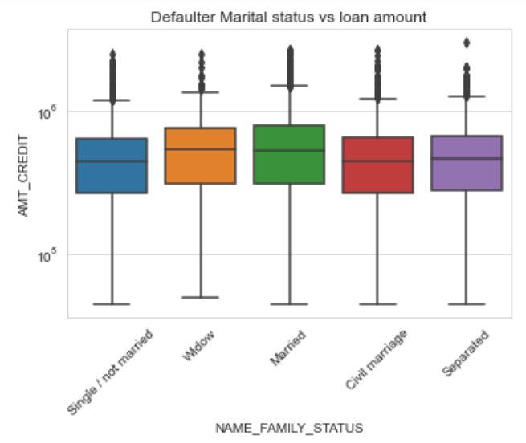
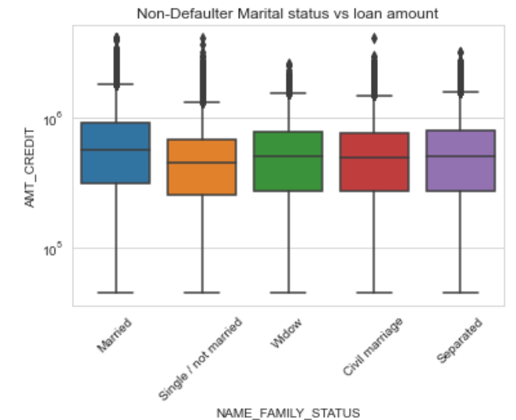
Marital status vs Loan amount
Above graphs of Marital status vs loan amount for Defaulter and Non-Defaulter, appears to be similar. Single/ Not married appears be on the higher side to be a defaulter. Married Non-Defaulter has higher loan amount than other.

Slide 30
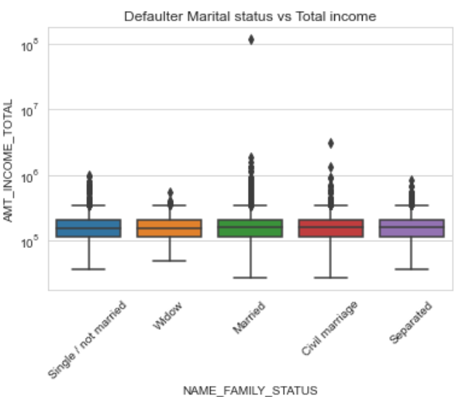
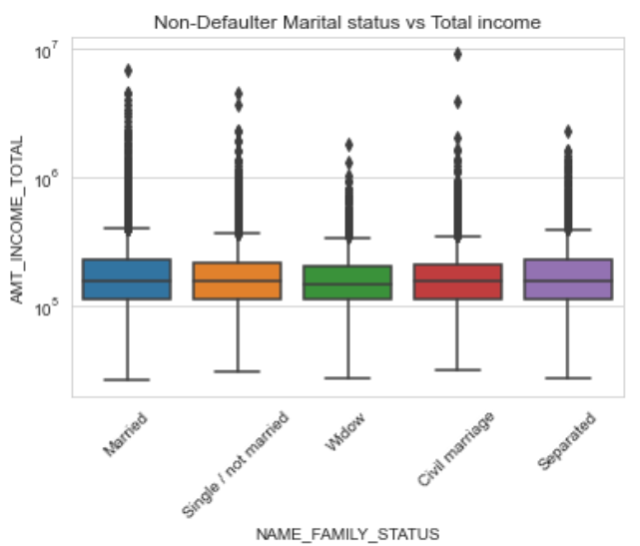
Marital status vs Income
Above graphs of Marital status vs Total income for Defaulter and Non-Defaulter, can observe: 'Single/not married', ‘Separated', 'civil married' and 'Married' are having higher income

Slide 31
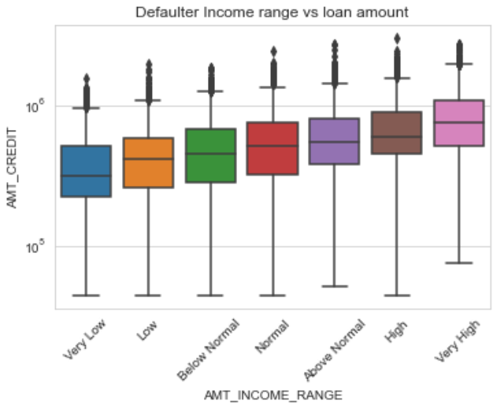
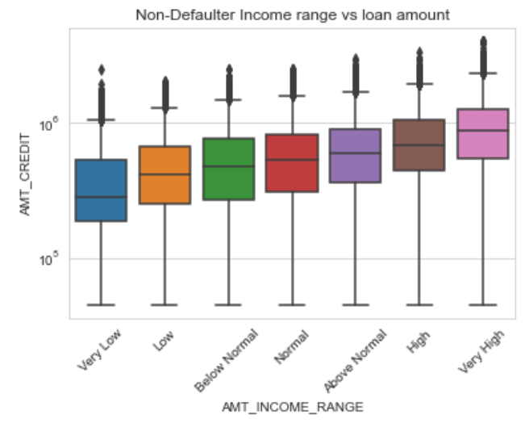
Income range vs Loan credit
Above graphs of Marital status vs loan amount for Defaulter and Non-Defaulter, appears to be similar. Lower income range has low credit/loan amount. Also, there are few outliers : in non-defaulter with very low income range and in defaulters with high income range.

Slide 32
Bivariate analysis
for categorical variables vs categorical variables

Slide 33


Income range vs Gender
From the above graphs, We can observe:
  Male count is higher than Female in defaulter list. Female defaulter are more in 'Very low' and 'Low' income.
  Female count is higher than Male in Non-defaulter list, under all range of income.

Slide 34


Income type vs Gender
From the above graphs, We can observe:
  Male count is more than female in defaulter list. Majority of defaulters are working type.
  Females count is more than male in non-defaulter list. Majority of loans credited for 'Working', 'Commercial associate' and 'State servant'. There is less no. of loan credited to 'Students', 'Pensioner', Businessman' and lesser number credited during maternity leave.

Slide 35


Contract type vs Gender
From the above graphs, We can observe:
  Male count is more than female in defaulter list. Majority of defaulters are from Cash loans as this type of loan is preferred most by the clients.
  Female count is more than Male in Non-defaulter list. Majority of the loans are of Cash loan which is preferred more than Revolving loans.

Slide 36

Occupation type vs Gender
From the above graph, we can observe Male count is more than female in defaulter list. We can observe increase in defaulter % who are 'Laborers', 'Sales staff', 'Drivers'.

Slide 37

Occupation type vs Gender
From the above graph, we can observe Female count is more than Male in Non-defaulter list.We can observe decrease in defaulter % who are 'Core staff'.

Slide 38


Education type vs Gender
In the above graph, we can observe:
  Female non-defaulters is more than Male. Less number of loan provided for clients with academic degree and Majority of loan given/applied by the clients with 'Secondary' / 'Higher education’
  Male is leading in the defaulter list. Interesting observation is Male with academic degree education is not seen as defaulter here. Since, Majority of loans given for education type 'Secondary' and 'Higher education' defaulter under this type is also high.

Slide 39
Bivariate analysis
for Numerical variables vs Numerical variables

Slide 40

Analysis of different numerical variables for Defaulters
Here, 4 numerical columns compared with each other– Loan amount , Annuity Income and Goods price.
In the plots, at ax[0][3] and ax[3][0], loan amount vs goods price, we can observe positive linear correlation.

Slide 41

Top 10 Correlation for client with payment difficulties

Slide 42

Analysis of different numerical variables for Defaulters
Here, many numerical columns are compared with each other. Higher positive number indicate more direct relatedness and lesser or negative number indicate inverse proportionality.
Observation from the graphs are:
Loan amount vs number children are inversely proportional
Loan amount, Goods price, Annuity are directly proportional.
Loan amount, Annuity vs companies region rating are inversely proportional
Population of region where client lives vs companies region rating are inversely proportional

Slide 43

Analysis of different numerical variables for Non-Defaulters
Here, many numerical columns are compared with each other. Higher positive number indicate more direct relatedness and lesser or negative number indicate inverse proportionality.
Observation from the graphs are:
Positive correlation between Credit vs Annuity, Goods price, Income and vice-versa.
Negative correlation between Population of region where client lives vs rating of the region where client lives, Region Rating vs Credit, Annuity, Goods price, Income; Similar, observation seen for family size and number of children. Also, can observe that if client's permanent address does not match contact address--then it doesn't match with work address either

Slide 44




Analysis of previous application data:
Read previous_data.csv file
Fixing errors in data
Checking for Missing values count %
Dropping columns where >99% of data is missing

Slide 45


Univariant analysis on previous application for Categorical data
NAME_CONTRACT_STATUS
CLIENT TYPE
We can observe majority of clients are Repeater and 18% are new client
We can observe majority of loan are approved for previous applicant

Slide 46


LOAN REJECTION REASON
NAME_PORTFOLIO
We can observe more than 50% of previous application is for POS and 35% is for cash
We can observe that more than 50% of applicants have rejected the loan due to HC and 18% due to limit.

Slide 47


WEEKDAY_APPR_PROCESS_START
LOAN PAYMENT TYPE
We can observe that 99% clients preferred to pay cash through the bank.
We can observe lesser number of applicant on weekend/Sunday.

Slide 48
Univariant analysis on previous application for Numerical data

Slide 49

LOAN ANNUITY
We can observe some outliers and non-normal distribution for AMT_ANNUITY data in previous application. Outliers are present in clients annuity and Q1 is smaller than Q3 for annuity distribution.

Slide 50

LOAN CREDIT
We can observe some outliers and non-normal distribution for AMT_CREDIT data in previous application. There are some outliers and Q1 is almost overlapping with lower fence and it's smaller than Q3 for credit distribution.

Slide 51

GOODS_PRICE
We can observe some outliers and non-normal distribution for AMT_GOODS_PRICE data in previous application. There are some outliers and Q1 is almost overlapping with lower fence and it's smaller than Q3 for Goods price distribution.

Slide 52



Merging Target data from New_applicant with Prev_applicant for Analysis
Created new DF for TARGET and Current applicant ID
New DF is merged with previous applicant data
Merged Dataset split into 2 set based on Target 0/1

Slide 53
Univariant Analysis of Merged applicant data

Slide 54

CONTRACT STATUS
From the above graph we can observe that percentage of defaulter are more with clients who had previously refused the loan

Slide 55

CONTRACT TYPE
From the above graph we can observe that percentage of defaulter are more with Cash loan. Also, there is decrease % in defaulters who had consumer loan type and increased % of defaulters who had revolving loan.

Slide 56
Bivariant Analysis of Merged applicant data

Slide 57

CONTRACT STATUS vs LOAN PURPOSE
From the graph, we can observe :
Most of loans are rejected for repair purpose than approved.
For 'Buying house/home', Urgent needs', 'weddings', 'Car repair'- there are no unused offer for these category but there is higher rate of refusal than approval.

Slide 58

TARGET vs LOAN PURPOSE
From the graph, we can observe that:
Loans taken for 'Repair' purpose has more defaulters.
Loans taken for 'Buying garage' has less defaulters

Slide 59


From the graph, we can observe that more defaulters are from new clients who had previously canceled the loan.
From the graph, we can observe that clients with 'Cash loan' / 'Revolving loans' who has previously refused loan tend be on the higher defaulter side.

Slide 60

From the above graph, we can observe that clients who chose 'Cashless from the account of employer' who has previously unused loan offer appears to be the defaulter on higher side. Less defaulters is seen with clients who chose 'Non-cash payment from account'.

Slide 61
Insights from analysis are:
  Prefer Female having normal and above type of income range, as there is less percentage of difficulties observed in loan payment.
  Senior citizens and Middle aged adults are having lesser difficulty than young adults and adults in loan payments.
  Married applicant with lesser family members are on the lower side of being defaulter, though their loan amounts are higher than others. Applicant who are Single and those who lives with their parents have higher chance of being defaulter.
  Prefer applicant with Higher and above education type as applicant with ‘Secondary’ or incomplete higher’ find it difficult with loan payments. Also, majority of loans are given to 'Secondary' / 'Higher ‘.
  There are no defaulter Male applicant with academic degree education. However, less number of loans provided to them. Prefer applicant with academic degree education but at less loan credit.
  Increase loan credits to applicants - 'Students', 'Pensioner', Businessman' and females during maternity leave.
  Working applicant get majority of loan, hence forth, more defaulters are seen here. So, lessen the loan credit amount or provide with lesser interest rates.
  Applicants working as 'Laborers', 'Sales staff', 'Drivers’ are on higher side of being defaulter. As mentioned above, prefer them over less loan credit.
  Majority of defaulters are seen for applicants with Cash loans. So, prefer digital method of payment. Avoid 'Cashless from the account of employer’, prefer 'Non-cash payment from account’ type of loan.
  Applicant who previously refused/cancelled loan find it difficulty with loan payments.
  Majority of loans is taken for 'Repair' purpose and defaulters rate is also for the same. However, loans credited for 'Buying garage' has less defaulters.
  50% of applicants have rejected the loan due to HC and 18% due to limit:
    Most of loans are rejected for repair purpose than approved.
    No unused offer 'Buying house/home', Urgent needs', 'weddings', 'Car repair' purposes.

